Slide 1
NJ Transit + Amtrak Rail Performance Analysis
By
Ramasubramanian Subramanian
01/20/2024

Slide 2
Overview and problem statement
The busiest passenger rail line in the United States, Amtrak also operates passenger rail service; together the NJ Transit and Amtrak operate nearly 750 trains across the NJ Transit rail network. This data is organized into a monthly performance report of nearly every train trip on the rail network with the features; date, train ID, stop sequence, station train is traveling from, station ID of train origin, station train is traveling to, train destination ID, scheduled time, actual time, and delay in minutes. We will clean and analyze these features for further machine learning.
In this analysis, we are going to find the answers for the below questions based on PCA/K-Means and Tsne/GMM approach through unsupervised models
Which cluster contains the most train delay on Friday?
Which cluster contains the most train delays for the rush hour in the weekday?

Slide 3
Data analyzed
In this experiment, I will explore NJ Transit + Amtrak Rail Performance Analytics
Using PCA and K-means to do the clustering (visualizations and many clusters, justify using silhouette scores)
For PCA/K-means (K>= 4), draw the bar graphs to answer the following questions:
Which cluster contains the most train delay on Friday?
Which cluster contains the most train delays for the rush hour in the weekday?
Using T-sne and GMM to do the clustering (visualizations and many clusters, justify using silhouette scores)
For T-sne/GMM (K>= 4), draw the bar graphs to answer the following questions:
Which cluster contains the most train delay on Friday?
Which cluster contains the most train delays for the rush hour in the weekday?
Dataset Link: https://www.kaggle.com/pranavbadami/nj-transit-amtrak-nec-performance.

Slide 4
Approach
Data Exploration
PCA with Kmeans
Run PCA and apply PCA to Kmeans
Find the best cluster value based on silhouette score
Run the Kmeans model based on the best cluster value
Find the clusters which contains most train delays on friday and most train delays for the rush hour in weekday
tSNE with GMM
Run tSNE and apply tSNE to GMM
Find the best cluster value based on silhouette score
Run the GMM model based on the best cluster value
Find the clusters which contains most train delays on friday and most train delays for the rush hour in weekday

Slide 5
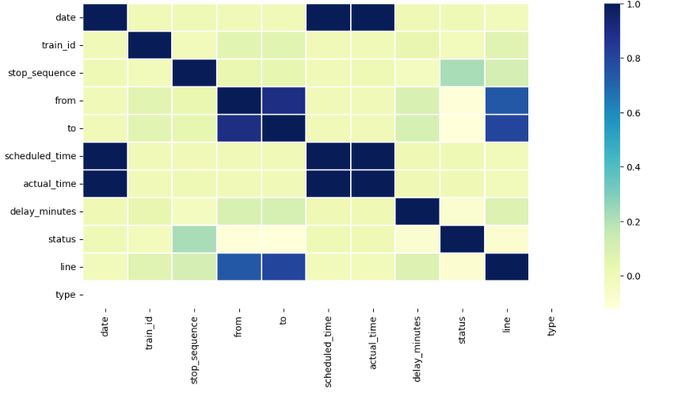
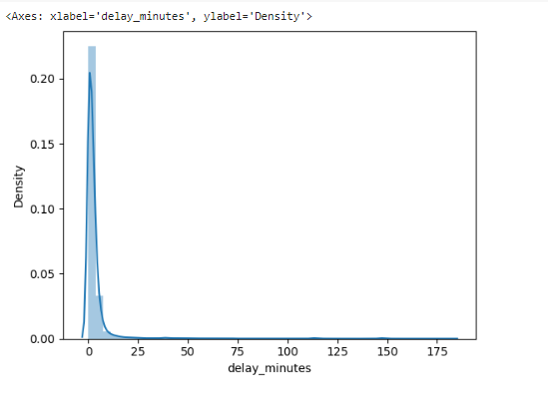
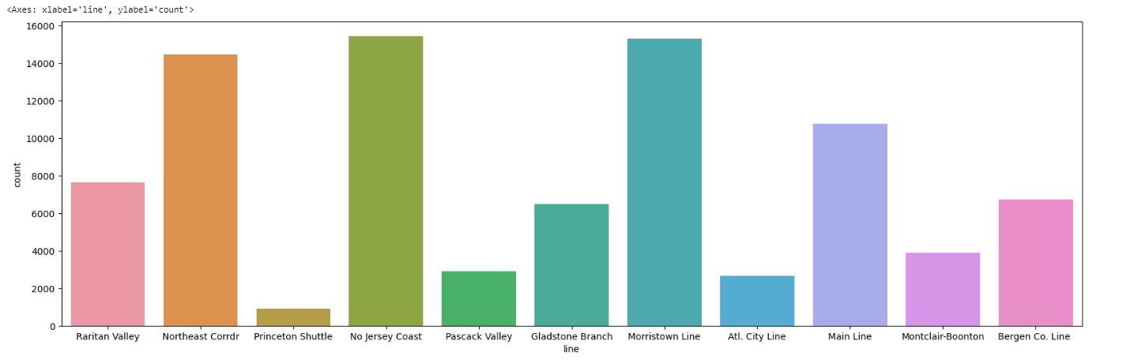
Implementation Steps
Data Exploration
Drop ‘na’ values
Replace null values with mean
Convert the columns into correct data type
Remove unique columns
Understand the data distribution

Slide 6
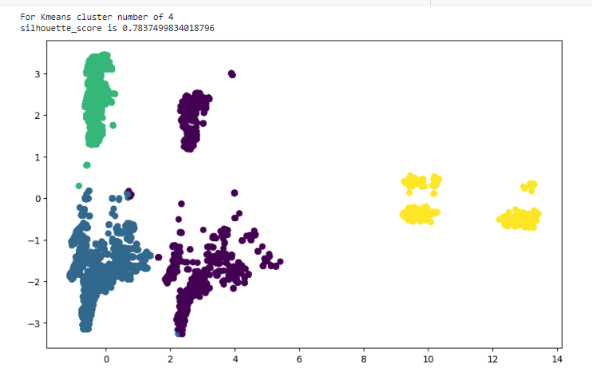
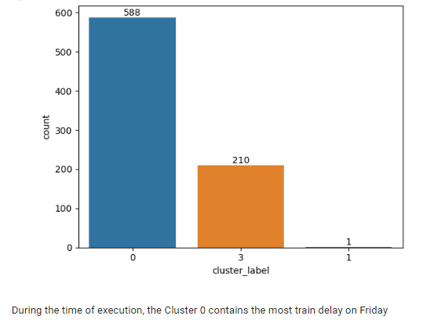
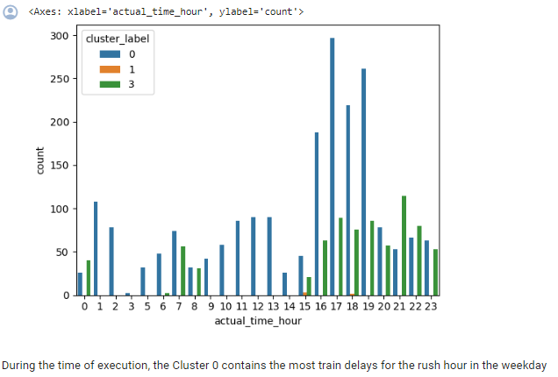
Implementation Steps
PCA/KMeans Model
Encoding the object columns
Standardize the values to one scale
Based on Inertia, Cluster 4 have better silhouette score 0.78
Run the KMeans model with cluster 4
Cluster 0 have most train delays on friday and rush hour on weekdays

Slide 7
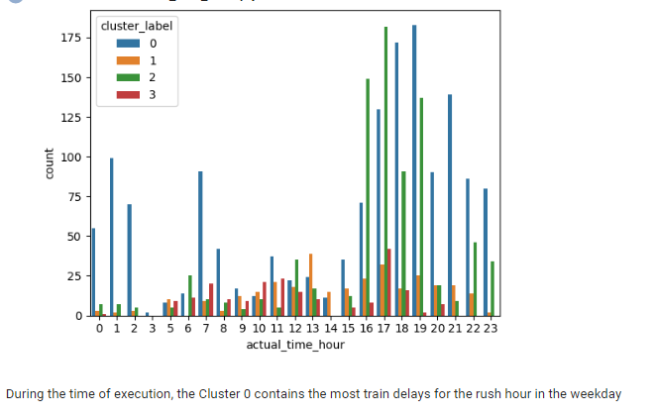
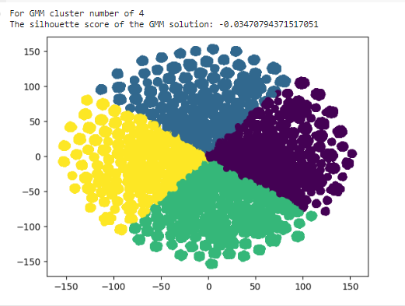
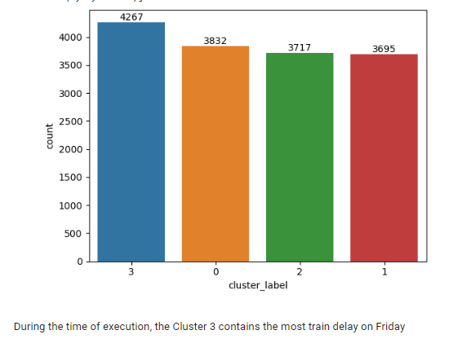
Implementation Steps
tSNE/GMM Model
Encoding the object columns
Standardize the values to one scale
Based on silhouette score, Cluster 4 is better
Run the GMM model with cluster 4
Cluster 3 have most train delays on friday and Cluster 0 have most train delays during rush hour on weekdays

Slide 8
Conclusion
Based on the Analysis of KMeans Clusters using PCA and the GMM Clusters using t-SNE,
KMeans Clusters using PCA:
1) Performed model with a KMeans value of 4 and a silhouette score of .78
2) Cluster 0 contains the most train delay on Friday and also the most train delays for the rush hour in the weekday
GMM Clusters using t-SNE:
1) Performed model with a GMM value of 4 and a silhouette score of -0.025
2) Cluster 3 contains the most train delay on Friday
3) Cluster 0 contains the most train delays for the rush hour in the weekday
https://colab.research.google.com/drive/1FC4g2fkq297pXYG58ZOZQSZjJLSMk7H7#scrollTo=U_dyxw4dYKZM

Slide 9
Questions?

Slide 10
Thank You

